Slide 1
Navigating Challenges: Leveraging DistilBERT for Autonomous Vehicles Disengagement Insights
An Nguyen 05-23-2024

Slide 2
Contents
Autonomous Vehicles Overview
Problem Statement
Data Collection & Preprocessing
EDA & Visualization
Multiclass Text Classification Model
Model Evaluation
Conclusion
Recommendation

Slide 3
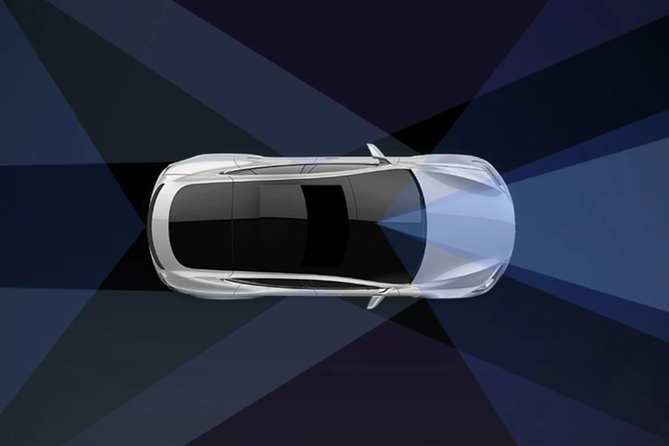
Autonomous Vehicles Overview
Autonomous vehicles (AV) technology can significantly reduce traffic accidents, improve road safety, and enhance mobility for individuals who cannot drive.
AV market size is USD 119.14 billion in 2023 and is projected to reach USD 1,075.95 billion by 2032.
However, AVs still face challenges in maintaining full autonomy and often requiring disengagements where human drivers take over.
Disengagements due to perception errors, planning issues, hardware failures, and driver interventions.

Slide 4
02. Problem Statement
Understanding and categorizing these disengagements is crucial for improving the reliability and safety of autonomous vehicles. Filtering through disengagement reports are time consuming and laborious.
Objectives:
Analyze California disengagements reports to identify the most common characteristics of AV disengagements.
Develop a Multi-class Text Classification Model to categorize autonomous vehicle disengagement descriptions into predefined categories.
Evaluate the model and fine-tune the model to achieve at least an 80% accuracy score on the validation dataset.

Slide 5
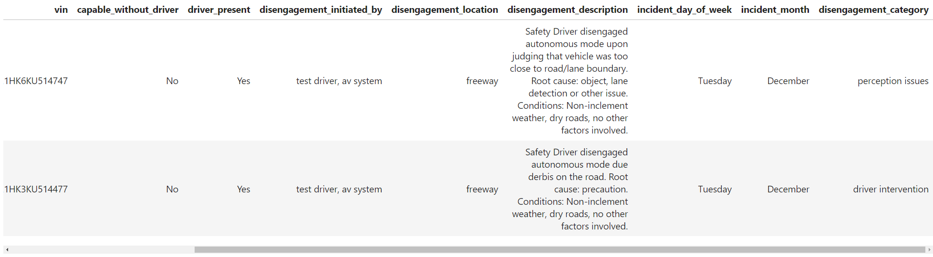
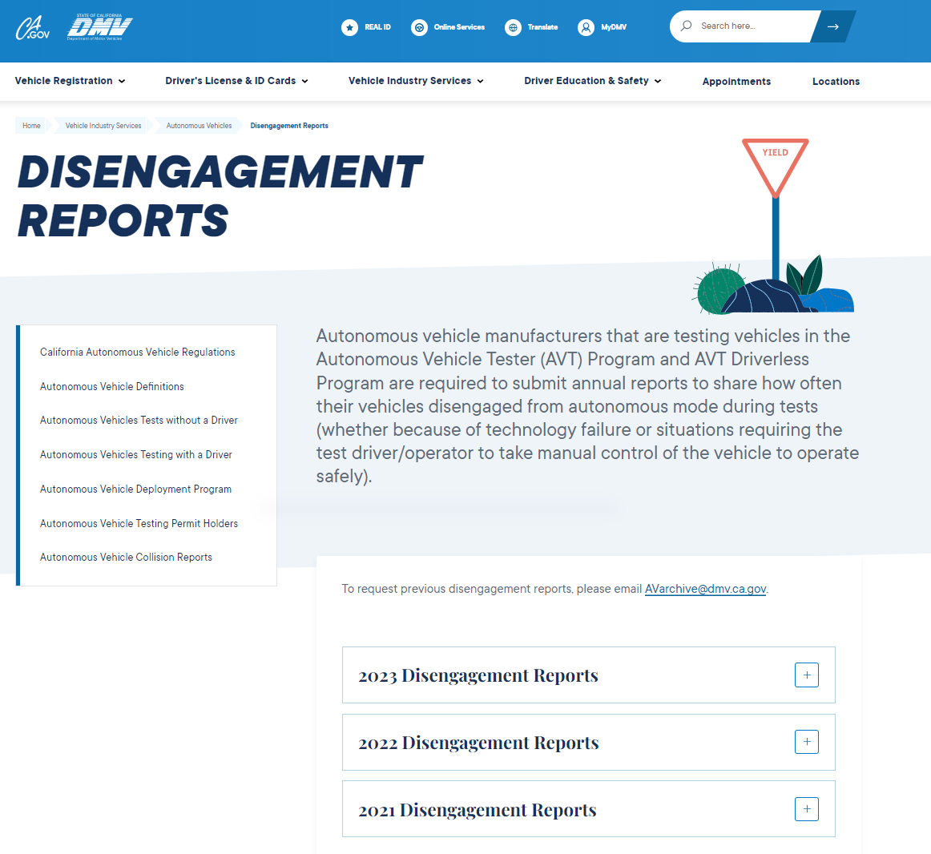
03. Data Collection & Preprocessing
Collect disengagement reports from California DMV website for 2021, 2022, and 2023.
Inspect the dataset for completeness and identify any missing or corrupted data entries.
Convert disengagement descriptions texts into tokenized sequences.
Encode the categorical labels of disengagement reasons
Separate into training (80%) and validation (20%) sets
Full set: 17454 rows, Train set: 13963 rows, Test set: 3491 rows.
All three sets include 3 columns (description, disengagement_category, and encoded_category).
Analyze and visualize the distribution of disengagement by locations, initiators, AV Manufacturers, disengagement occurrences.

Slide 6
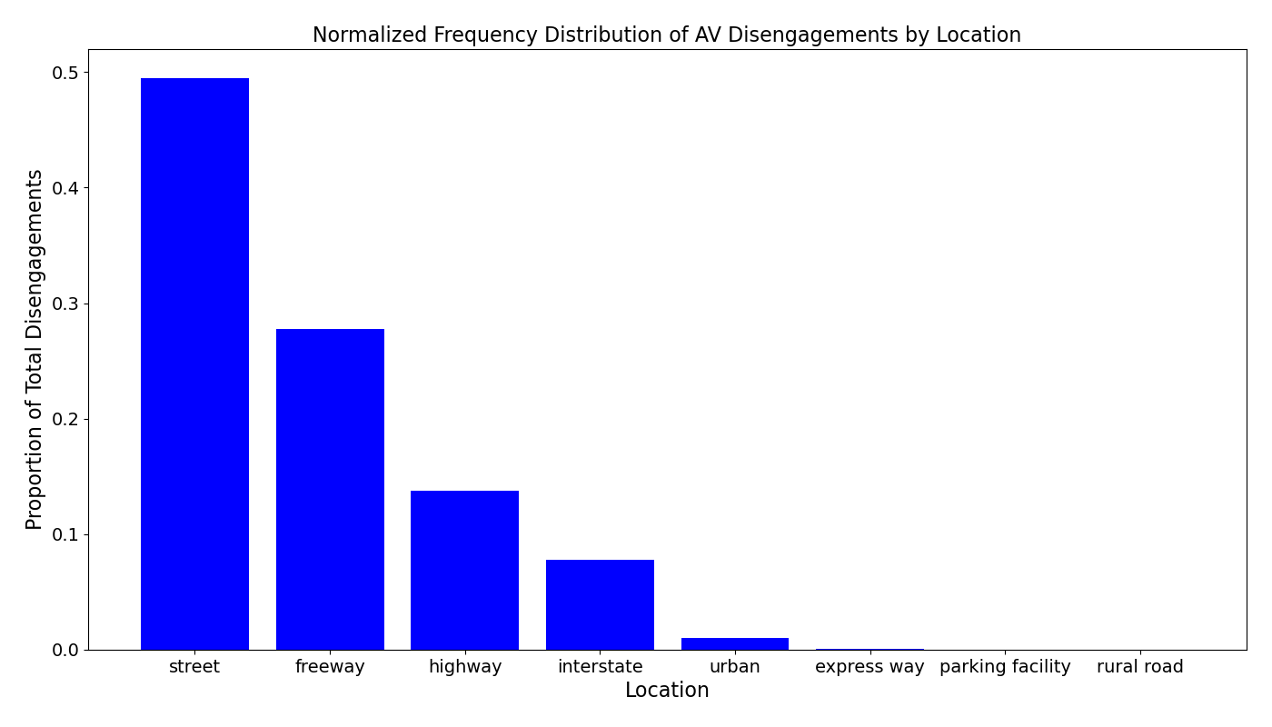
The majority of autonomous vehicle disengagements occurred on streets, accounting for nearly 50% of all reported incidents.

Slide 7
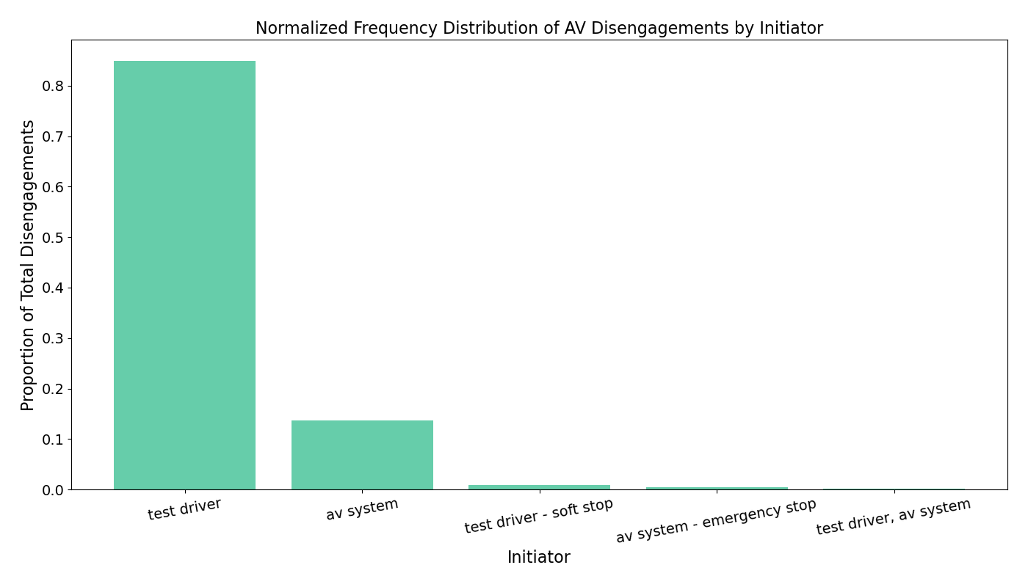
The majority of disengagements were initiated by test drivers, accounting for approximately 85%. The AV system initiated about 14% of disengagements.

Slide 8
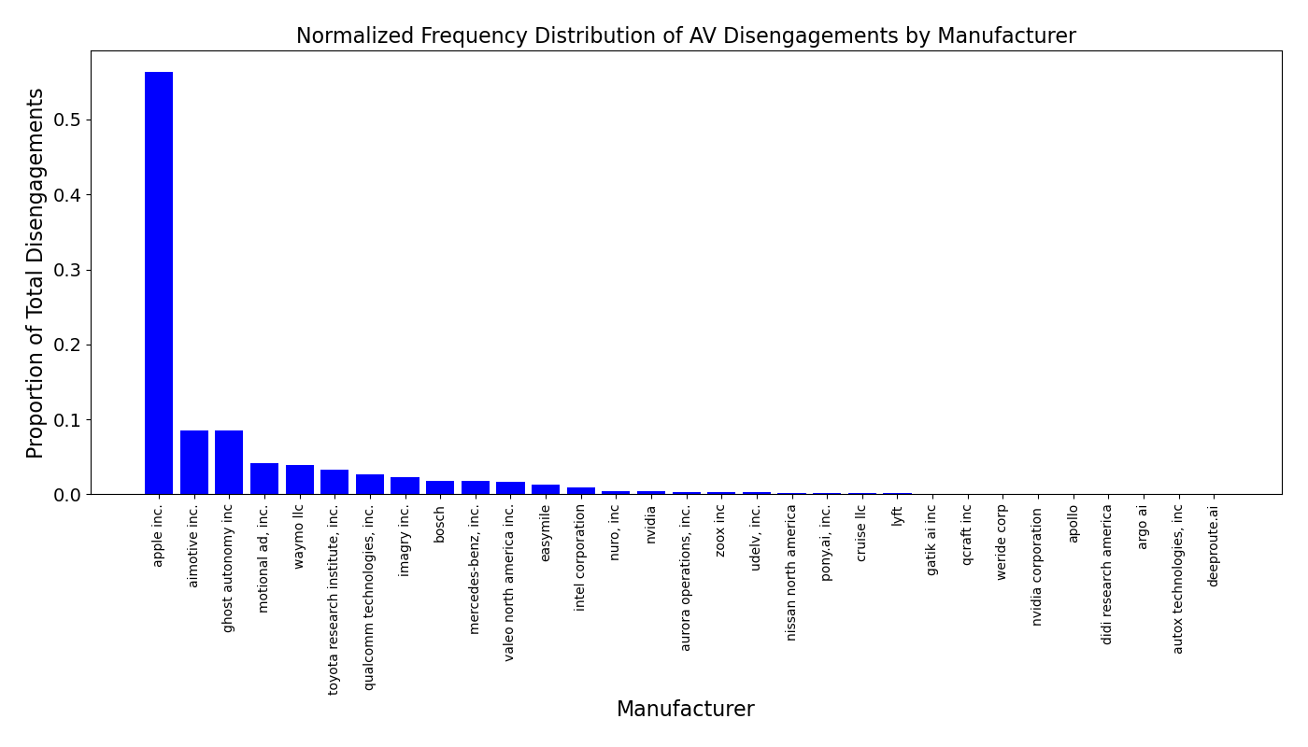
Disengagement distribution varies significantly across manufacturers, with Apple Inc. reporting about 56% of total disengagements from 2021 to 2023. Tesla Inc. does not report disengagements or publish their safety metrics.

Slide 9
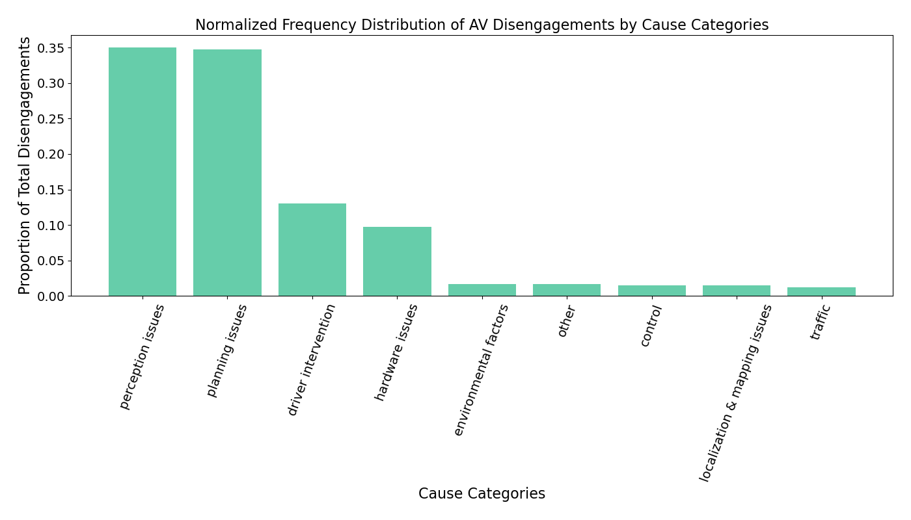
The majority of disengagements were caused by software perception issues and planning issues, accounting for approximately 35% respectively.

Slide 10
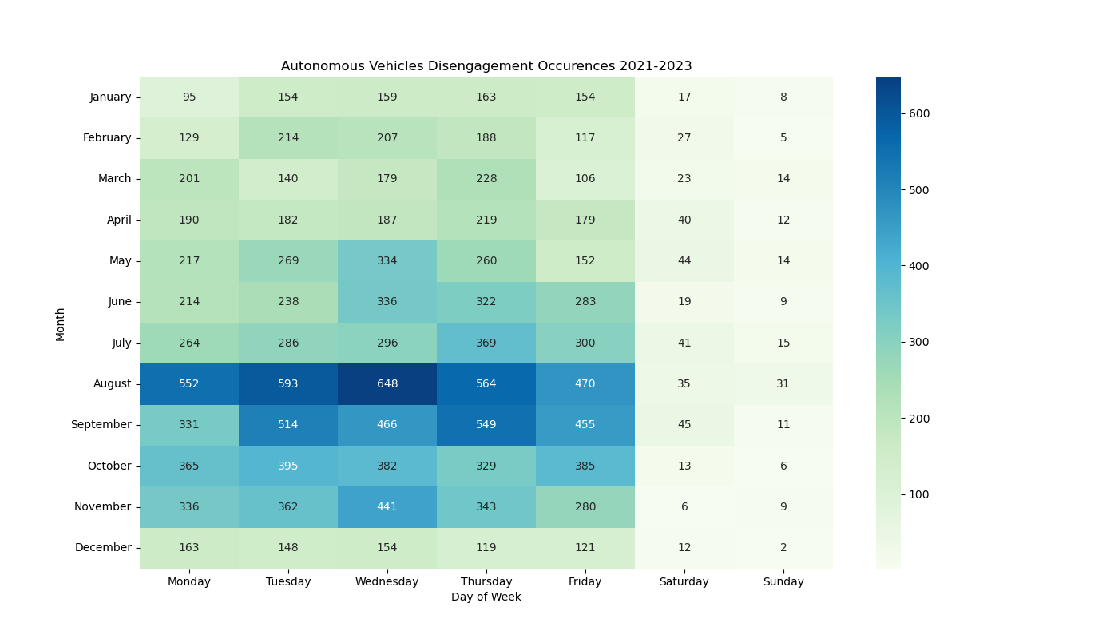
Disengagements are more frequent on weekdays and during the summer months. August exhibits the highest number of disengagements across all months.

Slide 11

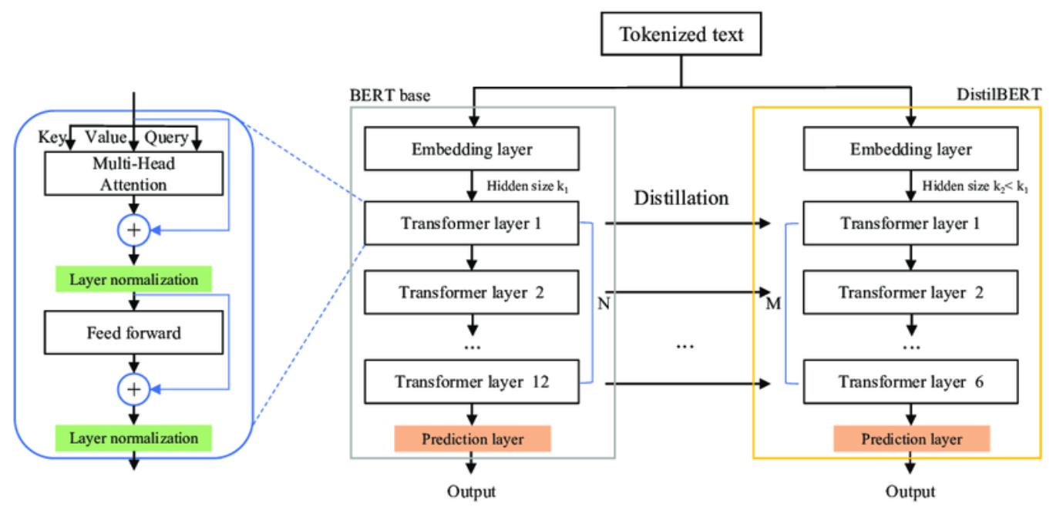
05. Text Classification Model
DistilBERT is a smaller, faster, and more efficient version of the pre-trained language model Bidirectional Encoder Representations from Transformers (BERT)
Tokenize disengagement descriptions
Encoded the disengagement categories/labels
Built a custom Neural Network and model fine-tuning (dropout and dense layers, Adam optimizer, learning rate scheduling, early stopping)
Track the model accuracy and loss

Slide 12
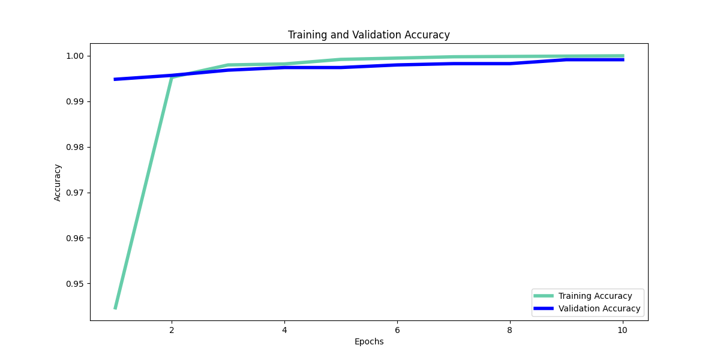
06. Model Accuracy

Slide 13
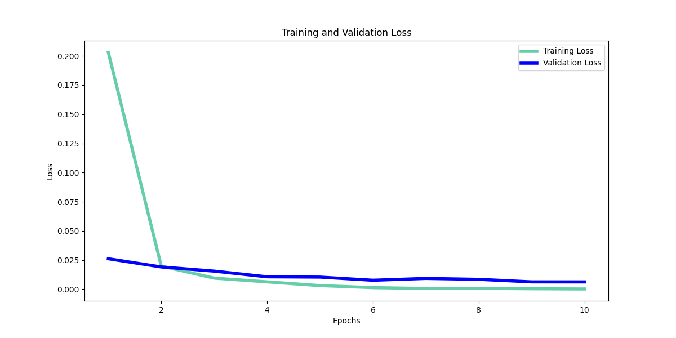
06. Model Loss

Slide 14
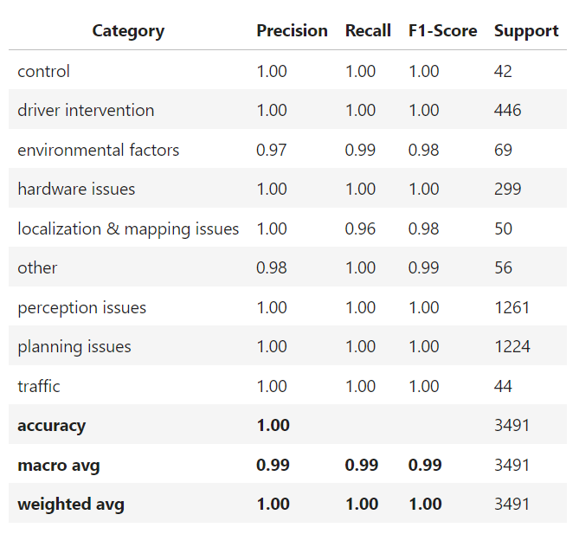
06. Validation Set Classification Report

Slide 15
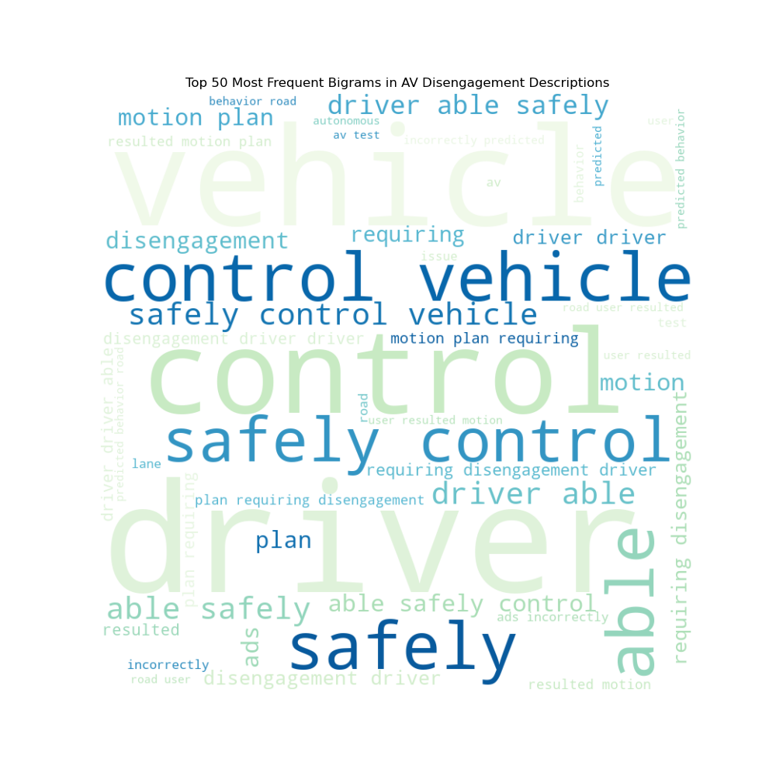
07. Conclusion
Disengagements occur most frequently when AV is in the street, initiated by the test driver, and owned by Apple Inc.
Disengagements are more frequent on weekdays and during the summer months, especially in August on Wednesdays.
DistilBERT-based multi-class text Classification model successfully categorized AV disengagement cause categories with 99% accuracy for train and validation datasets.

Slide 16
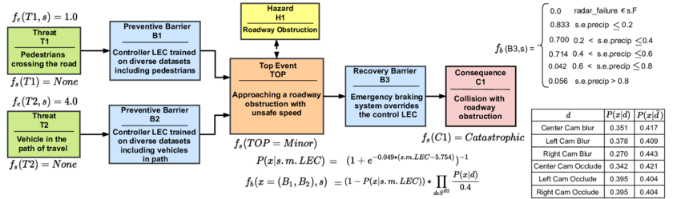
08. Model Limitations/Future Work
Explore different modeling architectures such as multi-label, multi-class text classification models.
Build a more advanced model to incorporate other data such as: driver presence, disengagement initiated by, and disengagement location.
Incorporate datetime information, real-time monitoring systems, and sensor data.
Implement a severity ranking for each disengagement.

Slide 17
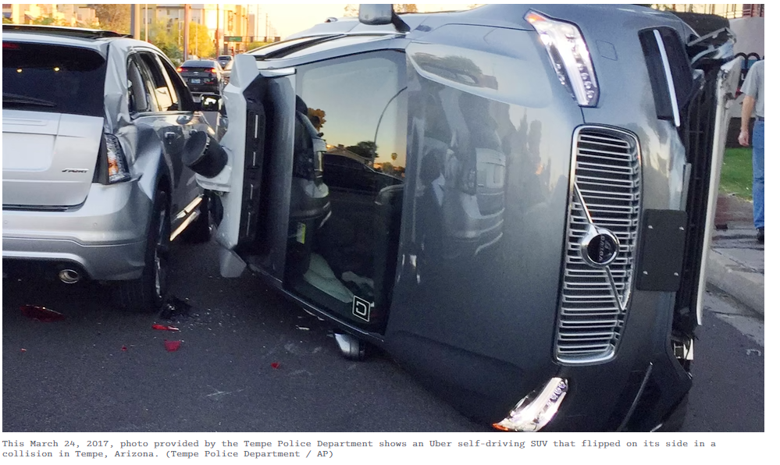
08. Recommendations
DMVs should collect more detailed disengagements data including geolocation tags and event coordinates, severity rankings of disengagements, detailed environmental conditions, traffic situations, and the behavior of other road users during disengagements.
Standardize reporting formats and criteria to ensure consistency and comparability across different companies and regions.
Encourage independent verification of disengagement reports to validate data accuracy and reliability.
Promote transparency and sharing of disengagement data.

Slide 18
Thank you!

